Slide 1
E-COMMERCE WEBSITE
Md Soaib Choudhary (2002900100086 / cse / section-b)
Mayank rajora (2002900100085 / cse / Section-b)

Slide 2
Objective
Develop a front-end clone of the E-commerce website using HTML, CSS, and JavaScript to recreate its user interface and navigation structure.
Ensure cross-browser compatibility and responsive design to provide a seamless user experience across various devices and browsers.
Provide a user-friendly and intuitive shopping experience.
Attract and acquire new customers for the platform.
Expand customer reach by breaking geographical barriers.

Slide 3
Objective
Implement secure and convenient payment options.
Keep up with the latest fashion trends and offer trendy products.
These objectives can serve as a starting point for our website, and you can further customize and prioritize them based on your specific business goals and target audience.

Slide 4
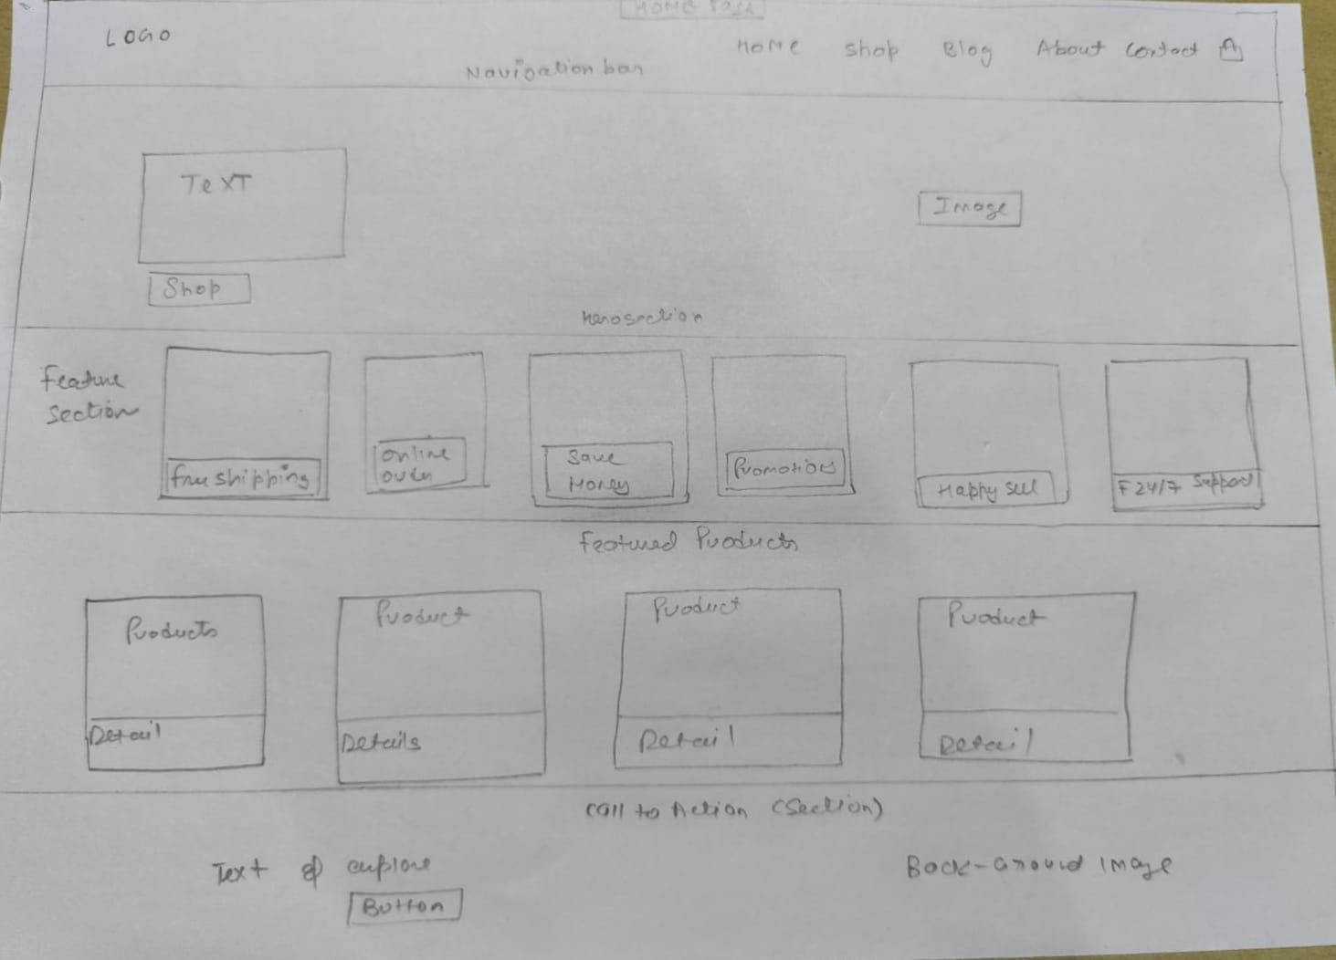
Layout : Homepage

Slide 5
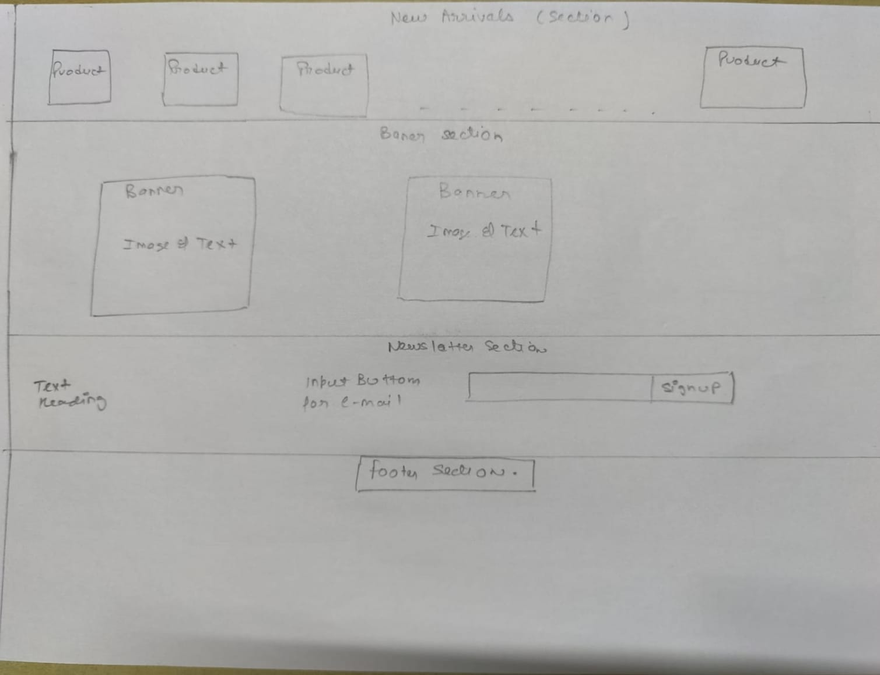
Layout : Homepage

Slide 6
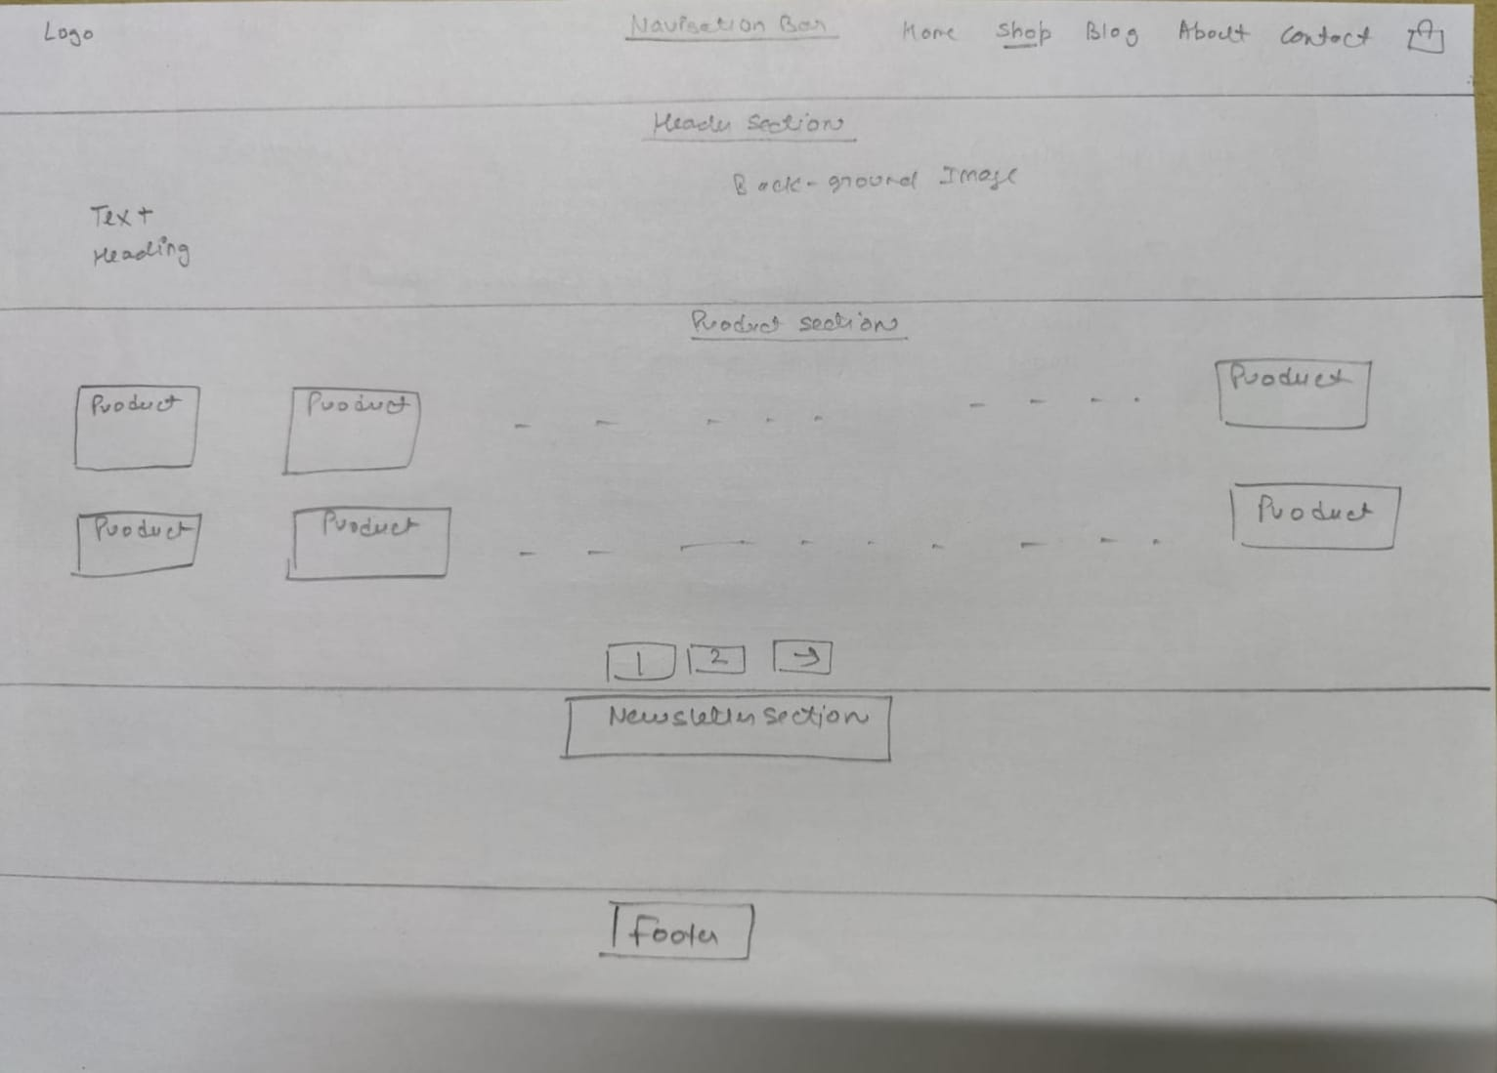
Layout : Shop page

Slide 7
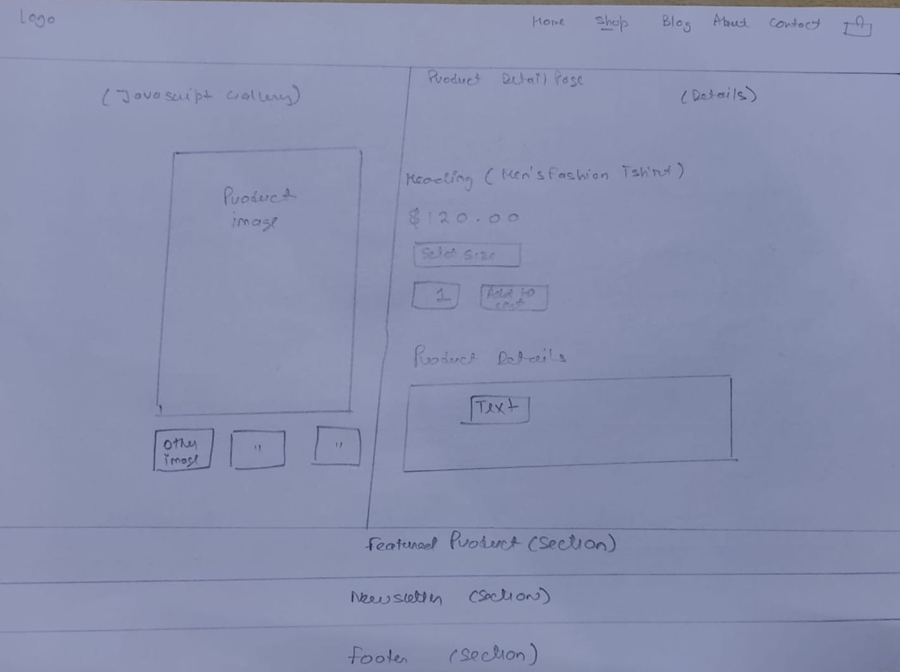
Layout : Product page

Slide 8
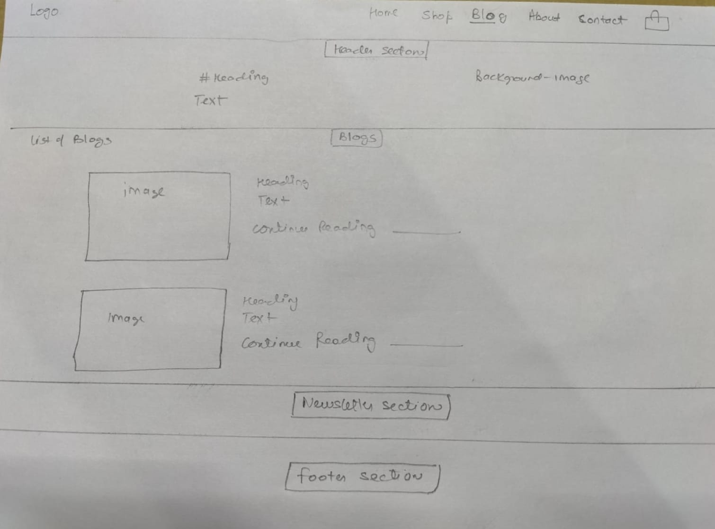
Layout : Blog page

Slide 9
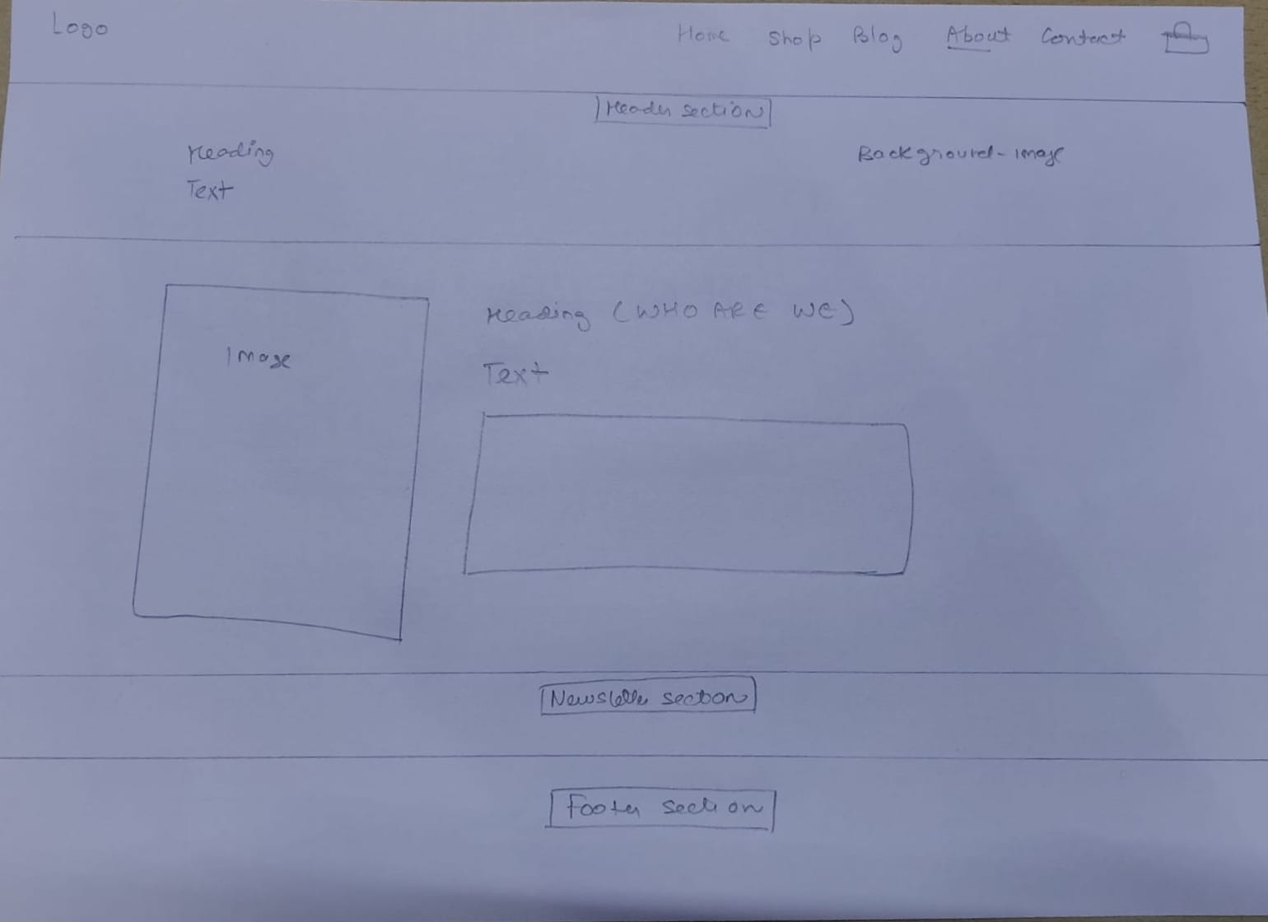
Layout : About page

Slide 10
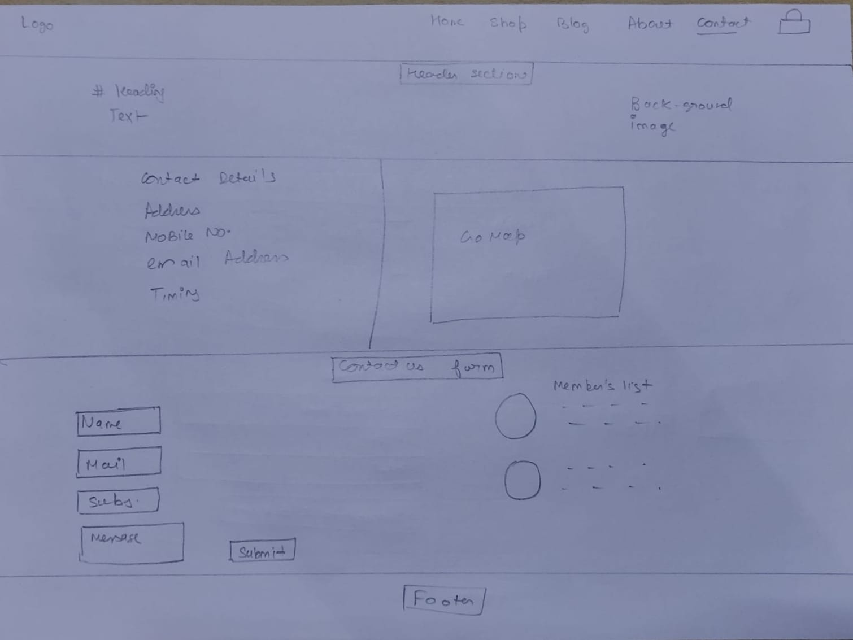
Layout: Contact page

Slide 11
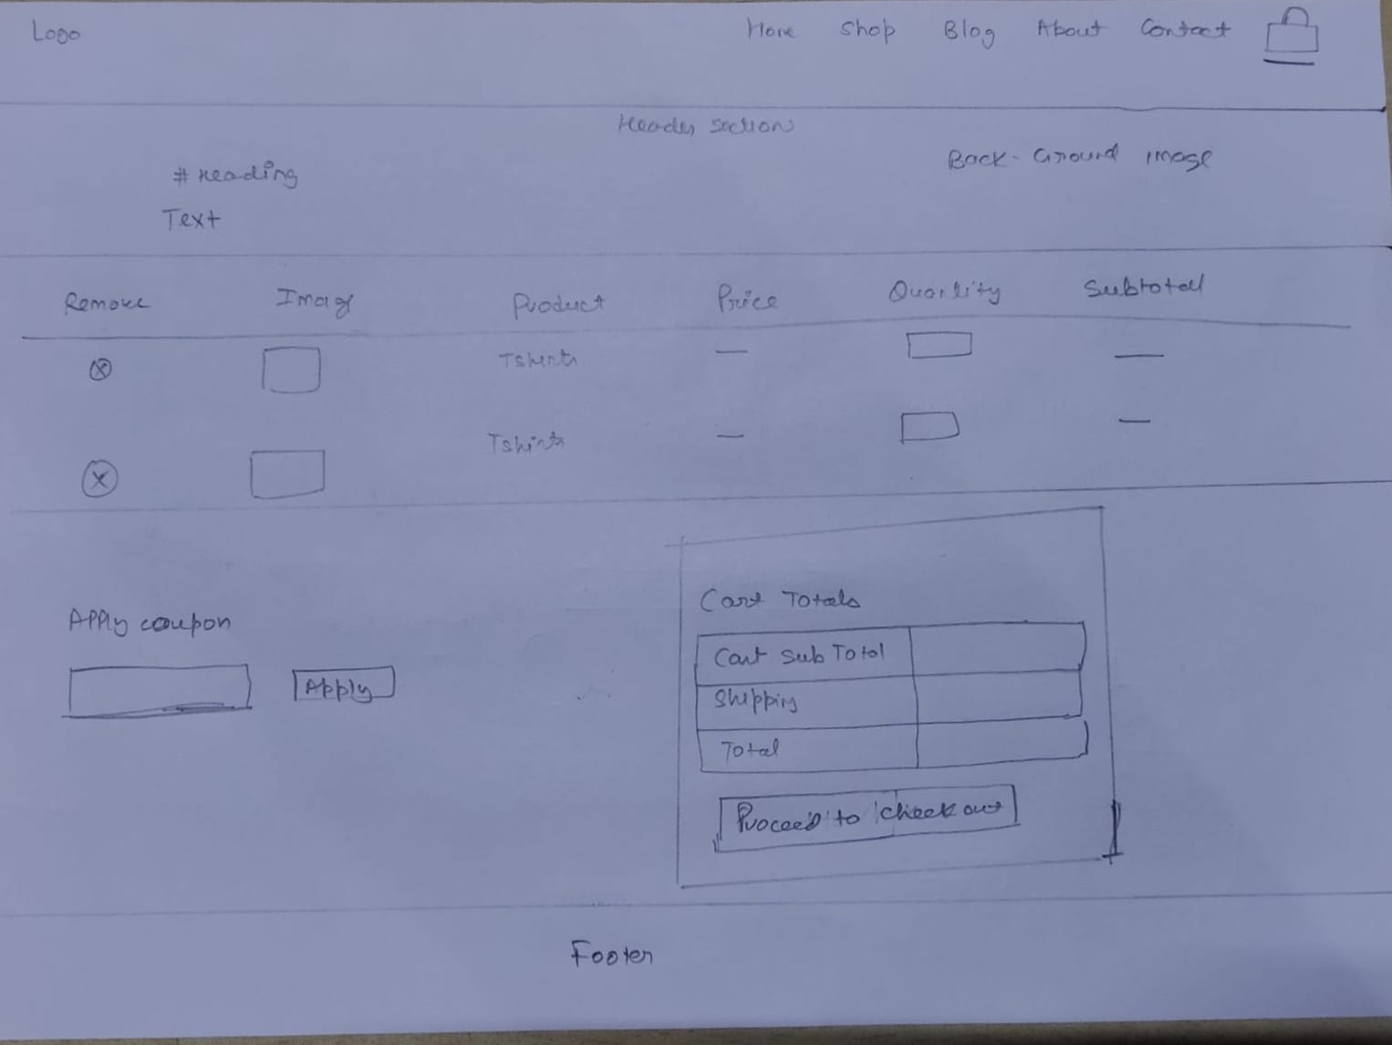
Layout : Cart page

Slide 12
Details about component
Navigation bar:
A navigation bar is a section of a graphical user interface intended to aid visitors in accessing information.
Navigation bars are implemented in operating systems, file browsers, web browsers, apps, web sites and other similar user interfaces.
Header:
A website header is a visual typographic strip or menu that typically runs across the top of a website.
It contains a number of clickable components, like a logo, navigational tags, login buttons, and more.

Slide 13
Details about component
Grids :
Uses a series of containers, rows, and columns to layout and align content.
Footer :
A footer is an additional navigation method for websites. It can hold links, buttons, company info, copyrights, forms and many other elements.

Slide 14


